Slide 1







Routing and Binding, Views, DI and Services
Model Binding and Model Validation, Files, Razor Syntax, Special View and Dependency Injection
SoftUni Team
Technical Trainers
Software University
https://softuni.bg

Slide 2
Table of Contents
Model Binding
Model Validation
Working with Files
Razor Syntax
Layout and Special View Files
HTML Helpers and Tag Helpers
Partial Views and View Components
Dependency Injection and Services

Slide 3
Have a Question?
sli.do #csharp-web

Slide 4

Model Binding

Slide 5
Model Binding (1)
Mapping data from HTTP requests to action method parameters
The framework binds request data to action parameters by name
Model binding can look through several data sources per Request
Form values – POST Request parameters
Route values – The set of Route values provided by the Routing
Query strings – The query string parameters in the URL
Even in headers, cookies, session, etc. in custom model binders
Request URL
PostsController
https://mysite.com/posts/edit/6
public IActionResult Edit(int? id)

Slide 6
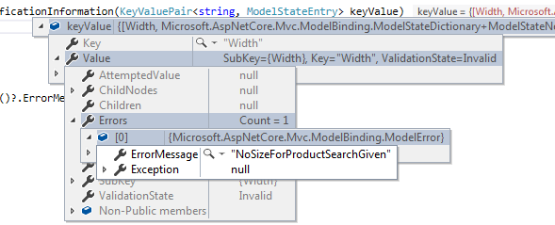
Model Binding (2)
The framework checks each of the data sources for a parameter value
If binding fails, the framework does not throw an error
Each entry in the controller's ModelState property is a ModelStateEntry
You can customize the built-in Model binding behavior
You can easily iterate over the errors in the ModelState

Slide 7
Model Binding (3)
Built-in Model binding behavior can be directed to a different source
The framework provides several attributes for that
Attribute | Description
[BindRequired] | Adds a model state error if binding cannot occur.
[BindNever] | Tells the model binder to never bind this parameter.
[From{source}] | Used to specify the exact binding source. [FromHeader], [FromQuery], [FromRoute], [FromForm]
[FromServices] | Uses dependency injection to bind parameters from services.
[FromBody] | Use configure formatters to bind data from request body. Formatter is selected based on Content-Type of Request.
[ModelBinder] | Used to override the default model binder, binding source and name.

Slide 8
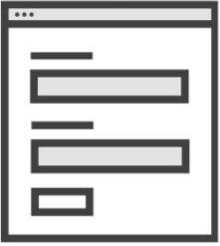
Incoming Request to MVC
Populate
Model State
Instance Created
by Model Binder
Model Binder
Validation
public MyController : Controller {
IActionResult Index(MyInputModel input)
{
if (ModelState.IsValid)
{
return View();
}
}
}
MyInputModel instance

Slide 9

Custom Model Binder (1)
Custom Model Binding can be completely customized
You need to create a BindingProvider and a Binder
[ModelBinder(BinderType = typeof(StudentEntityBinder))]
public class Student
{
public int Id { get; set; }
public string Name { get; set; }
public int Age { get; set; }
}
public class StudentEntityBinder : IModelBinder
{
public Task BindModelAsync (ModelBindingContext bindingContext)
{
// TODO: Do Magic ...
bindingContext.Result
= ModelBindingResult.Success(model);
return Task.CompletedTask;
}
}

Slide 10
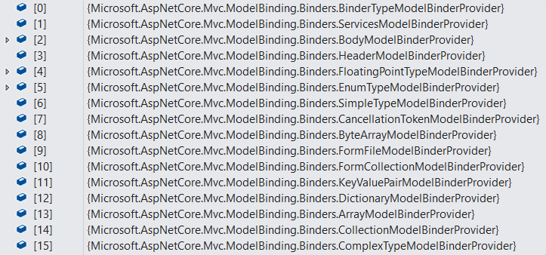
Custom Model Binder (2)
public class StudentEntityBinderProvider : IModelBinderProvider
{
public IModelBinder GetBinder(ModelBinderProviderContext context)
{
if(context == null) throw new ArgumentNullException(nameof(context));
if(context.Metadata.ModelType == typeof(Student))
return new BinderTypeModelBinder(typeof(StudentEntityBinder));
return null;
}
}
public void ConfigureServices(IServiceCollection services)
{
services.AddControllerWithViews(options =>
{
options.ModelBinderProviders
.Insert(0, new StudentEntityBinderProvider()); // Add custom binder to beginning
});
}

Slide 11



Model Validation

Slide 12
Model Validation
Validation is absolutely necessary before persisting data
In ASP.NET Core MVC, validation happens both on client and server
.NET provides us with an abstracted validation through attributes
Validation attributes make enforcing these requirements simple
They are specified at the property or parameter level
public class RegisterUserModel
{
[Required]
[StringLength(30)]
[EmailAddress]
public string Email { get; set; }
}

Slide 13
Custom Model Validation (1)
Validation attributes work for most needs, but not for all
Sometimes you need to implement your own validation attributes
public class IsBefore : ValidationAttribute
{
private const string DateTimeFormat = "dd/MM/yyyy";
private readonly DateTime date;
public IsBefore(string dateInput)
{
this.date = DateTime.ParseExact(dateInput, DateTimeFormat, CultureInfo.InvariantCulture);
}
protected override ValidationResult IsValid(object value, ValidationContext validationContext)
{
if ((DateTime)value >= this.date) return new ValidationResult(this.ErrorMessage);
return ValidationResult.Success;
}
}

Slide 14
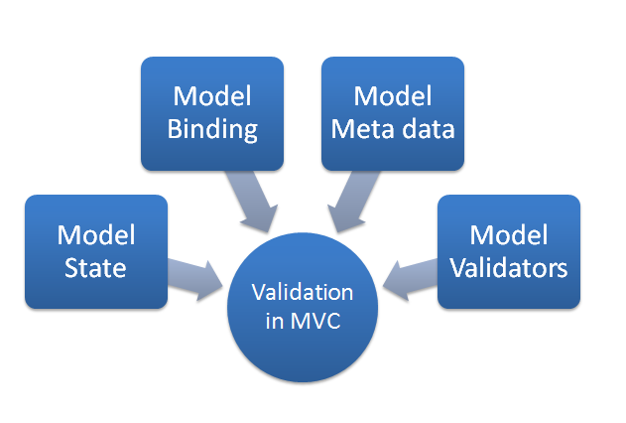
Custom Model Validation (2)
Then you can use it in your model
public class RegisterUserModel
{
[Required]
public string Username { get; set; }
[Required]
[StringLength(20)]
public string Password { get; set; }
[Required]
public string FirstName { get; set; }
[Required]
public string LastName { get; set; }
[IsBefore("01/01/2000")]
public DateTime BirthDate { get; set; }
}

Slide 15
Custom Model Validation (3)
You can also use validation directly in the Binding Model
This is done by using the IValidatableObject interface
public class RegisterUserModel : IValidatableObject
{
public string Username { get; set; }
public string Password { get; set; }
public string ConfirmPassword { get; set; }
public IEnumerable<ValidationResult> Validate(ValidationContext validationContext)
{
if(string.IsNullOrEmpty(Username)) yield return new ValidationResult("Username cannot be empty");
if(string.IsNullOrEmpty(Password)) yield return new ValidationResult("Password cannot be empty");
if(ConfirmPassword != Password) yield return new ValidationResult("Passwords do not match");
}
}

Slide 16
Incoming Request to MVC
Can you create a Model Binder
for MyInputModel?
IActionResult Index(MyInputModel input) {
return View();
}
Validation
ModelBinderProvider 1
Sorry, can't create a Model Binder for that
Value Providers
Default
Route
URL Query
FormData
ModelBinderProvider 2
Model Binder
Yes, I can, here you go
Input Formatters
Will never be checked
[FormBody] (if applicable)
JSON
XML
ModelBinderProvider 3

Slide 17

Uploading and Downloading Files
Files

Slide 18

Uploading Files (1)
ASP.NET Core MVC supports File Upload using simple model binding
For larger files, Streaming is used
Multiple-file upload is also supported
<form method="post" enctype="multipart/form-data"
asp-controller="Files" asp-action="Upload">
<input type="file" name="file"> <button type="submit" value="Upload" />
</form>
<form method="post" enctype="multipart/form-data" asp-controller="Files" asp-action="Upload">
<input type="file" name="files" multiple > <button type="submit" value="Upload" />
</form>

Slide 19


Uploading Files (2)
When uploading files using model binding, your action should accept:
IFormFile (for single file) or IEnumerable<IFormFile> (or List<IFormFile>)
[HttpPost("Upload")]
public async Task<IActionResult> Upload(List<IFormFile> files)
{
var filePath = Path.GetTempFileName(); // Full path to file in temp location
foreach (var formFile in files.Where(f => f.Length > 0))
{
using (var stream = new FileStream(filePath, FileMode.Create))
{
await formFile.CopyToAsync(stream);
}
} // Copy files to FileSystem using Streams
var bytes = files.Sum(f => f.Length);
return Ok(new { count = files.Count, bytes, filePath});
}

Slide 20




Downloading Files (1)
ASP.NET Core abstracts file system access through File Providers
File Providers are used throughout the ASP.NET Core framework
Examples of where ASP.NET Core uses File Providers internally
IHostingEnvironment exposes the app's content root and web root
Static File Middleware uses File Providers to locate static files
Razor uses File Providers to locate pages and views

Slide 21
Downloading Files (2)
To access physical files, you have to use PhysicalFileProvider
You'll have to initialize it with your server physical files folder path
Then you can extract information about the File
public IActionResult Download(string fileName)
{
// Construct the path to the physical files folder
string filePath = this.env.ContentRootPath + this.config["FileSystem:FilesFolderPath"];
IFileProvider provider = new PhysicalFileProvider(filePath); // Initialize the Provider
IFileInfo fileInfo = provider.GetFileInfo(fileName); // Extract the FileInfo
var readStream = fileInfo.CreateReadStream(); // Extact the Stream
var mimeType = "application/octet-stream"; // Set a mimeType
return File(readStream, mimeType, fileName); // Return FileResult
} // NOTE: There is no check if the File exists. This action may result in an error

Slide 22

Razor Syntax

Slide 23
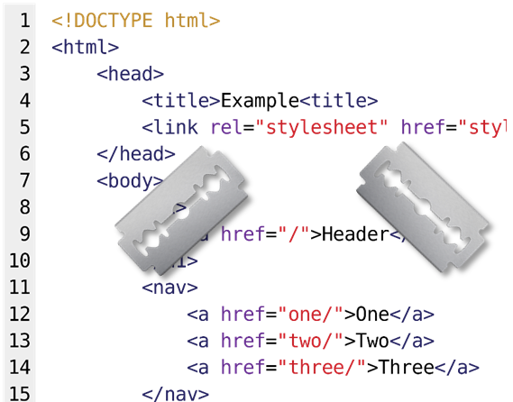
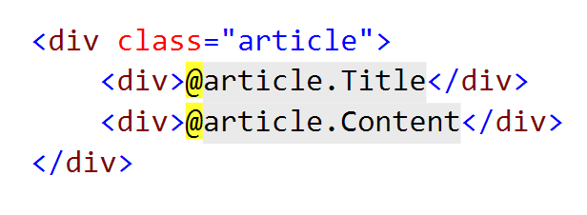
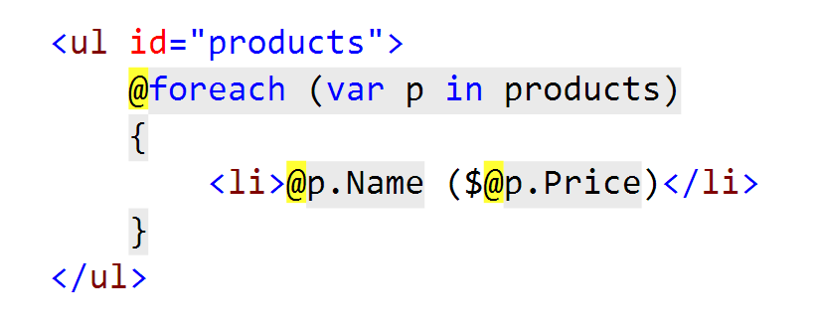
What is Razor?
Simple-syntax view engine
Code-focused templating approach
Easy transition between HTML and code
Examples: combining HTML and C#:

Slide 24
Razor Syntax (1)
@ – For values (HTML encoded)
@{ … } – For code blocks (keep the view simple!)
<p>
Current time is: @DateTime.Now!!!
Not HTML encoded value: @Html.Raw(someVar)
</p>
@{
var productName = "Energy drink";
if (Model != null) { productName = Model.ProductName; }
else if (ViewBag.ProductName != null) { productName = ViewBag.ProductName; }
}
<p>Product "@productName" has been added in your shopping cart</p>

Slide 25
Razor Syntax (2)
If, else, for, foreach, etc. C# statements
HTML markup lines can be included at any part
@: – For plain text line to be rendered
<div class="products-list">
@if (Model.Products.Count() == 0) { <p>Sorry, no products found!</p> }
else
{
@:List of the products found:
foreach(var product in Model.Products)
{
<b>@product.Name, </b>
}
}
</div>

Slide 26
Razor Syntax (3)
Comments
What about '@' and emails?
@*
A Razor Comment
*@
@{
// A C# comment
/* A Multi
line C# comment
*/
}
<!-- HTML Comment -->
<p>
This is the sign that separates email names from domains: @@<br />
And this is how smart Razor is: spam_me@gmail.com
</p>

Slide 27
Razor Syntax (4)
@(…) – Explicit code expression
@using – for including namespace into view
@model – for defining the model for the view
<p>
Current rating(0-10): @Model.Rating / 10.0 @* 6 / 10.0 *@
Current rating(0-1): @(Model.Rating / 10.0) @* 0.6 *@
spam_me@Model.Rating @* spam_me@Model.Rating *@
spam_me@(Model.Rating) @* spam_me6 *@
</p>
@using MyWebApp.Models;
@model UserModel
<p>@Model.Username</p>

Slide 28
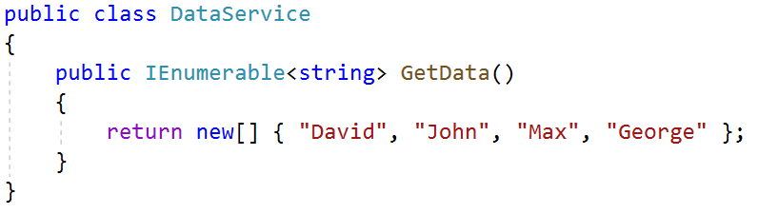
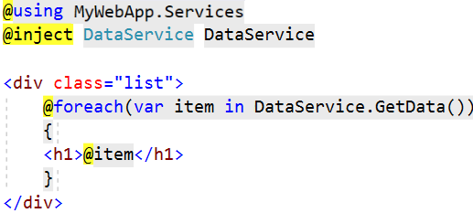
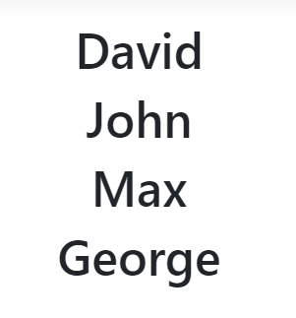
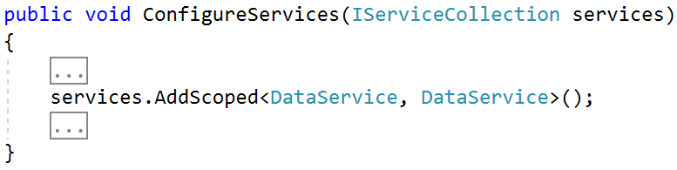
Views – Dependency Injection
ASP.NET Core supports dependency injection into views
You can inject a Service into a View by using @inject

Slide 29
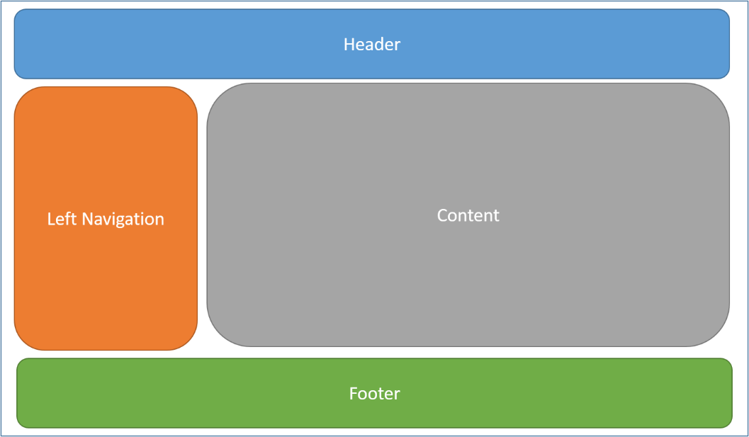
Layout and Special View Files

Slide 30
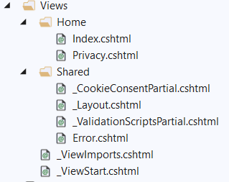
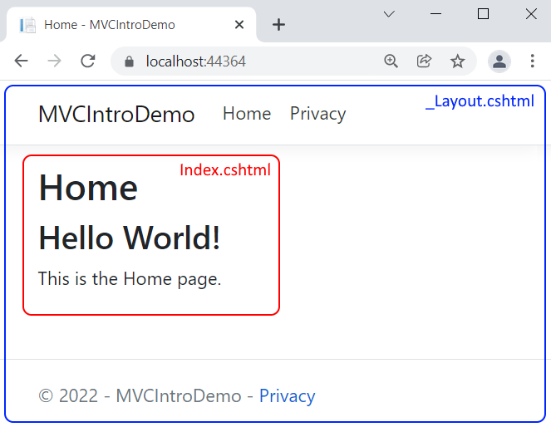
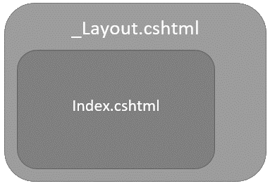
_Layout.cshtml
Defines a common site template (~/Views/Shared/_Layout.cshtml)

Slide 31
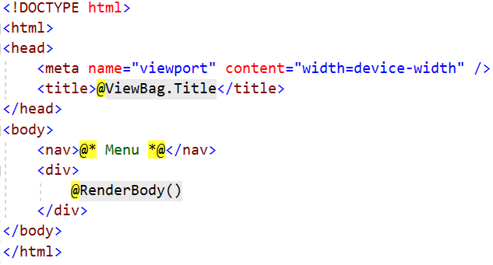
_Layout.cshtml (2)
Razor View engine renders content inside-out
First the View is rendered, and after that – the Layout
@RenderBody() – indicate where we want the views based on this layout to "fill in" their core content at that location in the HTML

Slide 32
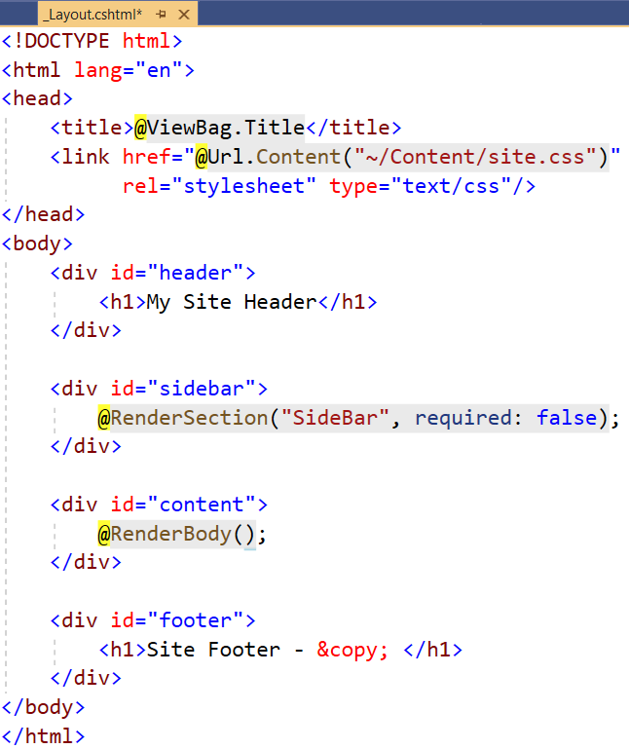
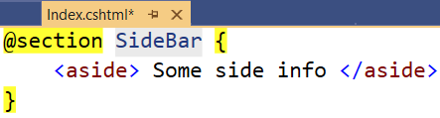
Sections
You can have one or more "sections" (optional), defined in views
Can be rendered anywhere in the layout page using the method RenderSection()
@RenderSection(string name, bool required)
If the section is required and not defined, an exception will be thrown (IsSectionDefined())

Slide 33
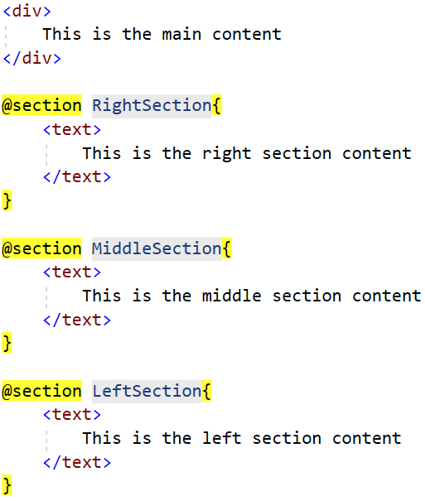
Scheme
Index.cshtml
_Layout.cshtml
Header
Left
Menu
RenderBody()
Right Menu
RenderSection
("LeftSection")
RenderSection
("MiddleSection)
RenderSection ("RightSection")
Footer

Slide 34
_ViewStart.cshtml
Views don't need to specify layout since their default layout is set in their _ViewStart file:
~/Views/_ViewStart.cshtml (code for all views)
Each view can specify custom layout pages
Views without layout:
@{
Layout = "~/Views/Shared/_UncommonLayout.cshtml";
}
@{
Layout = null;
}

Slide 35
_ViewImports.cshtml
If a directive or a dependency is shared between many Views, it can be specified globally in the ViewImports:
~/Views/_ViewImports.cshtml (code for all views)
This file does not support other Razor features
@using MyWebApp
@using MyWebApp.Models
@using MyWebApp.Models.AccountViewModels
@using MyWebApp.Models.ManageViewModels
@using Microsoft.AspNetCore.Identity
@addTagHelper *, Microsoft.AspNetCore.Mvc.TagHelpers

Slide 36
_ValidationScriptsPartial.cshtml
This file contains validation scripts in the form of a partial view
~/Views/Shared/_ValidationScriptsPartial.cshtml:
To use the scripts, render the partial view inside a view in a section
<script
src="~/lib/jquery-validation/dist/jquery.validate.min.js">
</script>
<script
src="~/lib/jquery-validation-unobtrusive/jquery.validate.unobtrusive.min.js">
</script>
@section Scripts {
<partial name="_ValidationScriptsPartial" />
}

Slide 37
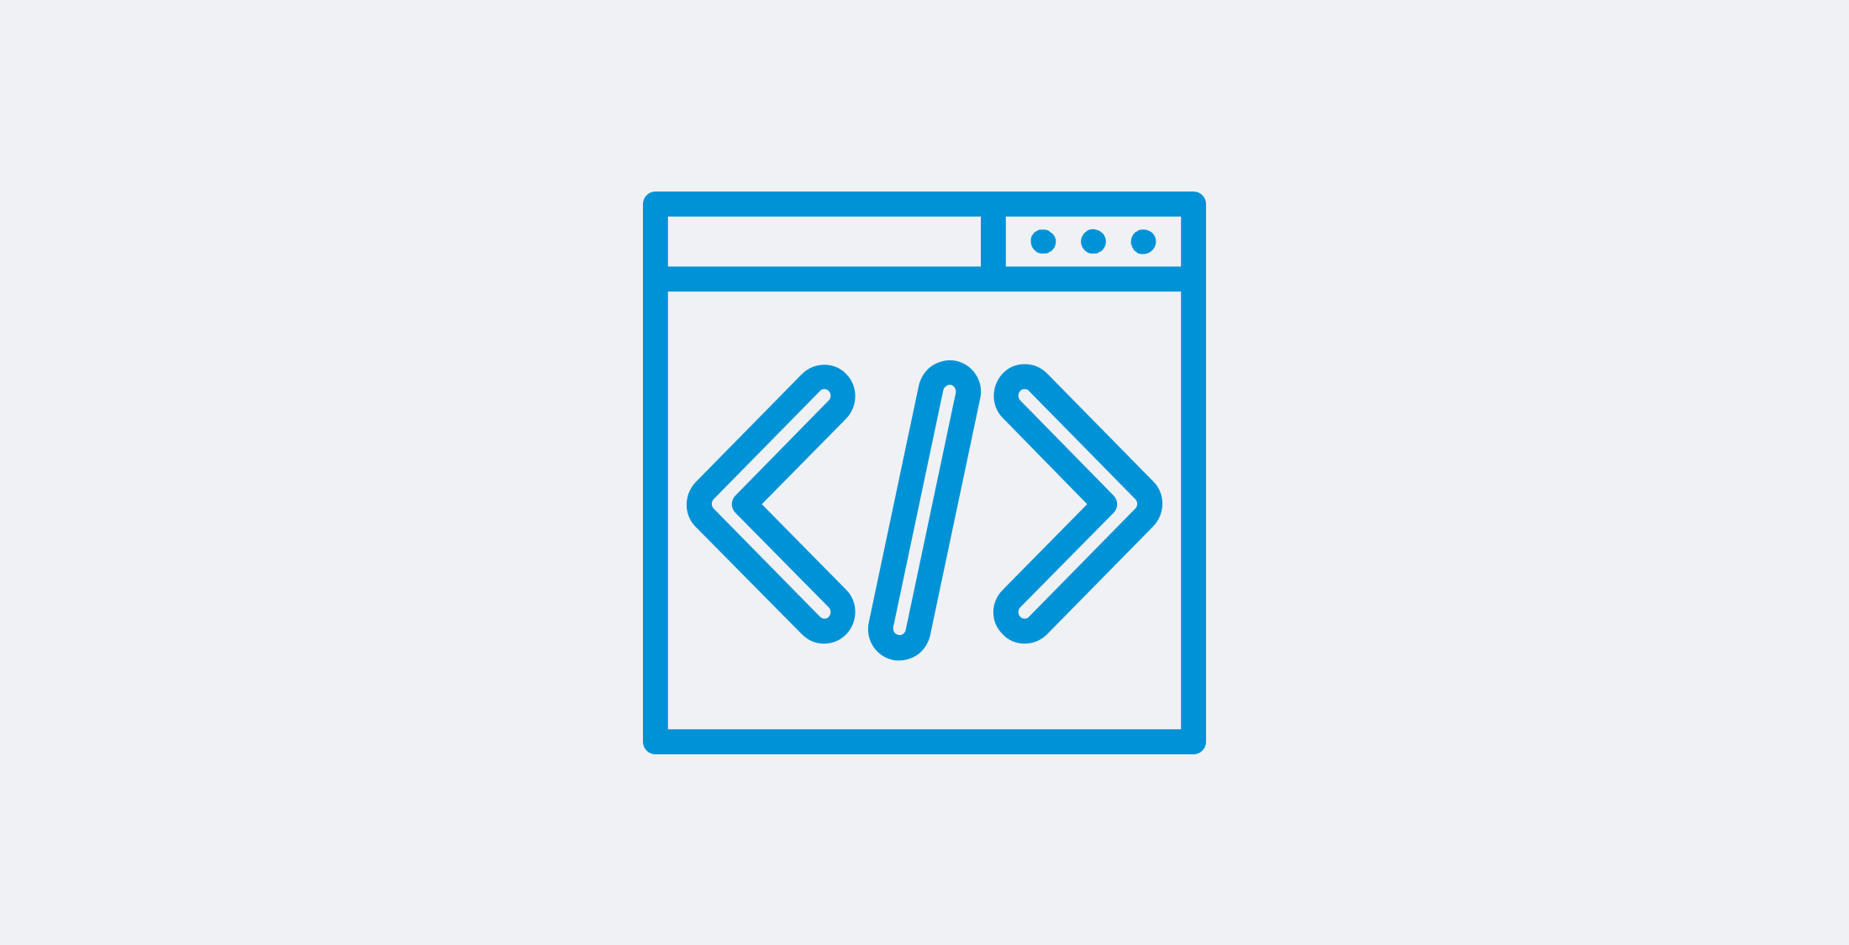
HTML Helpers and Tag Helpers

Slide 38
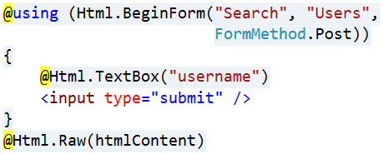
HTML Helpers
Each view inherits RazorPage
RazorPage has a property named Html
The Html Property has methods that return string can be used to:
Create inputs
Create links
Create forms
Avoid using HTML Helpers
Use Tag Helpers instead
HTML Helpers
@Html.ActionLink | @Html.TextBox
@Html.BeginForm | @Html.TextArea
@Html.CheckBox | @Html.Password
@Html.Display | @Html.Hidden
@Html.Editor | @Html.Label
@Html.DropDownList | @Html.Action

Slide 39


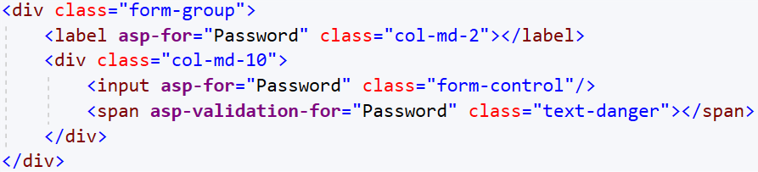
Tag Helpers
Tag Helpers enable the participation of Server-side code in the HTML element creation and rendering, in Razor views
There are built-in Tag Helpers for many common tasks
Forms, Links, Assets, etc.
There are custom Tag Helpers in GitHub repos and NuGet
Often start with asp-
Often start with asp-

Slide 40
Tag Helpers vs HTML Helpers
Tag Helpers attach to HTML elements in Razor Views
Tag Helpers reduce the explicit transitions between HTML & C#
Tag Helpers make the Razor markup quite clean and the views – quite simple
HTML Helpers are invoked as methods which generate content
HTML Helpers tend to include a lot of C# code in the markup
HTML Helpers use complex and very C#-specific Razor syntax in some cases

Slide 41

Creating Your Own Tag Helper
[HtmlTargetElement("h1")]
public class HelloTagHelper : TagHelper
{
private const string MessageFormat = "Hello, {0}";
public string TargetName { get; set; }
public override void Process(TagHelperContext context, TagHelperOutput output)
{
string formattedMessage = string.Format(MessageFormat, this.TargetName);
output.Content.SetContent(formattedMessage);
}
}
@using WebApplication;
@addTagHelper *, Microsoft.AspNetCore.Mvc.TagHelper
@addTagHelper WebApplication.TagHelpersHelloTagHelper, WebApplication
<div class="tag-helper-content">
<h1 target-name="John"></h1>
</div>

Slide 42
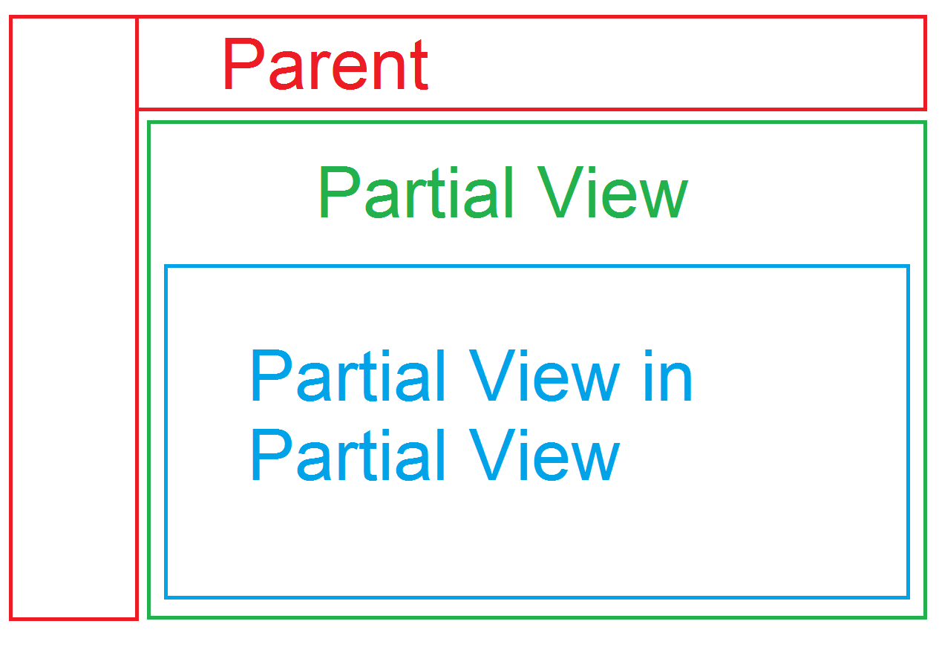
Partial Views and View Components

Slide 43
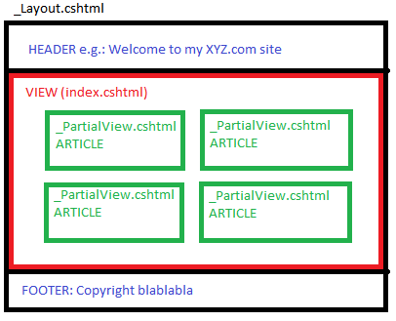
Partial Views
Partial Views render portions of a page
Break up large markup files into smaller components
Reduce the duplication of common view code
Razor partial views are normal views (.cshtml files)
Usually placed in /Shared/ or in the same directory where used

Slide 44
Use of Partial Views
HTML Helper for Partial Views
Tag Helper for Partial Views
@using WebApplication.Models;
@model ProductsListViewModel
@foreach (var product in Model.Products)
{
@await Html.PartialAsync("_ProductPartial", product);
}
@foreach (var product in Model.Products)
{
<partial name="_ProductPartial" model="product" />
}

Slide 45
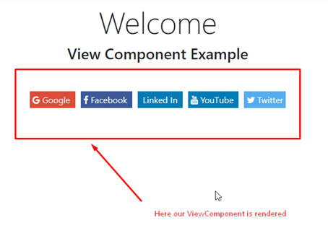
View Components (1)
View Components are similar to Partial Views, but much more powerful
No model binding
Depend only on the data provided to it
View Components:
Render a chunk rather than a whole
response (as in Html.Action())
Can have parameters and business logic
Typically invoked from a Layout page
Include the same separation of concerns and testability benefits between controller / view

Slide 46
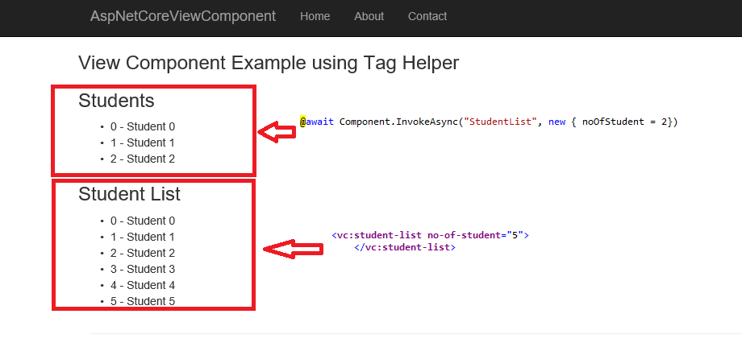
View Components (2)
View components are intended anywhere you have reusable rendering logic that's too complex for a partial view
Dynamic navigation menus
Login panels
Shopping carts
Sidebar content
Recently published articles
Tag cloud

Slide 47
View Components (3)
View Components consist of 2 parts:
A class – typically derived from ViewComponent
A result – typically a View
View Components
Define their logic in a method called InvokeAsync()
Never directly handle a Request
Typically initialize a Model which is passed to the View

Slide 48
Defining Your Own ViewComponent (1)
\ViewComponents\HelloWorldViewComponent.cs
Inherit the ViewComponent class
public class HelloWorldViewComponent : ViewComponent
{
private readonly DataService dataService;
public HelloWorldViewComponent(DataService dataService)
=> this.dataService = dataService;
public async Task<IViewComponentResult> InvokeAsync(string name)
{
string helloMessage = await this.dataService.GetHelloAsync();
this.ViewData["Message"] = helloMessage;
this.ViewData["Name"] = name;
return View();
}
}
Components don't handle requests directly
Async method with logic
They often initialize a model which is passed to the view
Typically return a view

Slide 49
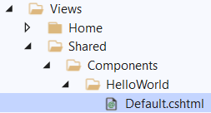
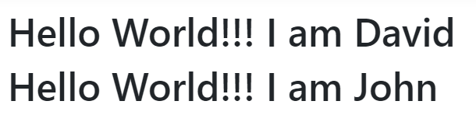
Defining Your Own ViewComponent (2)
\Views\Shared\Components\HelloWorld\Default.cshtml
<h1>@ViewData["Message"]!!! I am @ViewData["Name"]</h1>
\Views\Home\Index.cshtml
...
<div class="view-component-content">
@await Component.InvokeAsync("HelloWorld", new { name = "David" });
<vc:HelloWorld name="John"></vc:HelloWorld>
</div>
To use a Tag Helper, register the assembly of the view component using the @addTagHelper directive

Slide 50
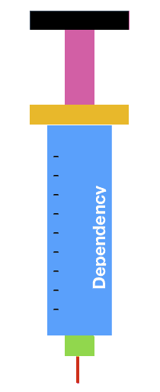
Dependency Injection
System
Design Pattern for IoC Implementation

Slide 51
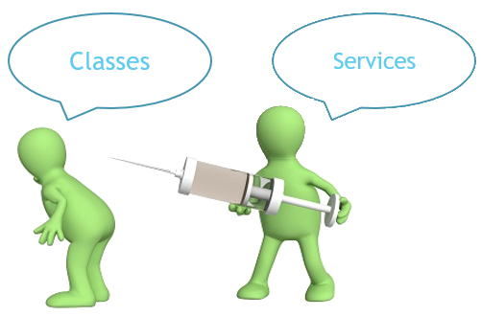
What is a Dependency?
Another object that your class needs
Other examples (Framework, Database, File System, Providers)
Classes dependent on each other are called coupled
Dependencies are bad because they decrease reuse
Customer class is dependent on concrete service
public class Customer
{
var customerService =
new CustomerService('Service');
}

Slide 52
Dependency Examples
Project
Framework
Service
Database
Class
Another Class

Slide 53
What is Dependency Injection?
Dependency Injection (DI) is a popular design pattern
It is a technique for achieving Inversion of Control (IoC)
Classes should declare what they need
Constructors should inject dependencies (constructor injection)
Dependencies (abstractions) are pushed in the class from the outside
Classes do not instantiate their dependencies
injection
Class B
Class A
injection
Class C

Slide 54
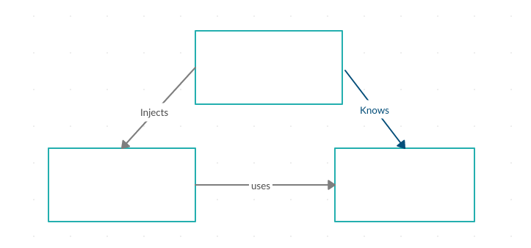
Dependency Injection Scheme
Framework for implementing automatic DI
Injector (IoC Container)
Client (CustomerController)
Service (ICustomerService +
CustomerService)

Slide 55
Constructor Injection
Decouples dependencies
Pros
Classes self document requirements
Works well without container
Always valid state
Cons
Many parameters
Some methods may not need everything
public class Customer
{
private ICustomerService customerService;
public Customer(ICustomerService service)
{
this.customerService = service;
}
}
The service comes from outside

Slide 56
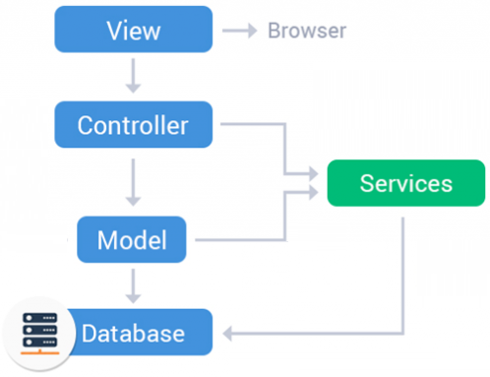
Services
Service Layer in MVC

Slide 57
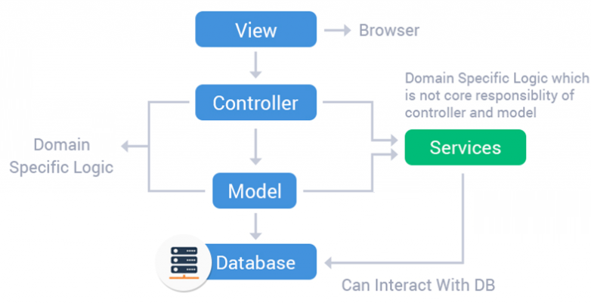
Service Layer
Service layer is an additional layer in an ASP.NET MVC app between controllers and database layer
Resolves the problem with duplicating code in controller actions
It contains business logic
Controller actions should not contain database logic
Controllers may get a model from the service layer and pass it to a view

Slide 58
MVC with Services
UI Layer
Service Layer
Request
Call
Controller
Service
Interact
Return result (may be a model)
Database
Response
View
Model

Slide 59
Application Services Configuration
Configuration options, by convention, are set in Program.cs
Services can be configured for Dependency Injection differently
Transient objects are always different. A new instance is provided to every controller and service
builder.Services.AddTransient<DataService>();
builder.Services.AddScoped(typeof(DataService));
builder.Services.AddSingleton<DataService>();
Singleton objects are the same for every object and request
Scoped objects are the same within a request. They are different across different requests

Slide 60
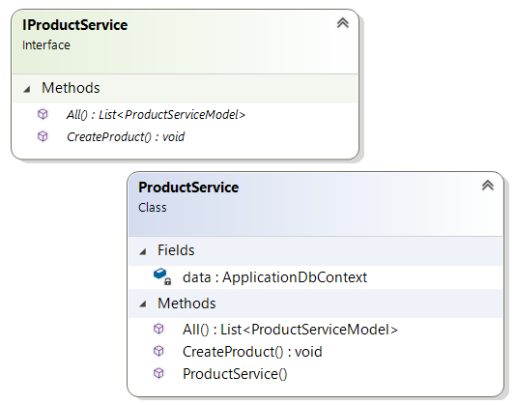
Services Demo
Service Classes and Services in Controllers

Slide 61
Service Interface + Configuration
Services are typically defined using interfaces
Interfaces define service methods
Configure the service in the Program.cs class
public interface IProductService
{
List<ProductServiceModel> All();
void CreateProduct(string name, string description);
}
Allows you to inject services into controller classes constructors via DI
builder
.Services
.AddTransient<IProductService, ProductService>();

Slide 62
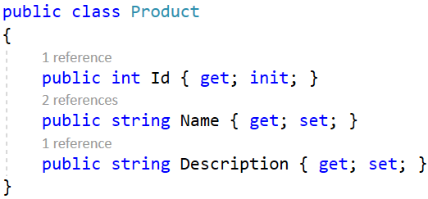
Service
Should contain the business logic
May interact with the database context
public class ProductService : IProductService
{
private readonly ApplicationDbContext data;
public ProductService(ApplicationDbContext data)
=> this.data = data;
public void CreateProduct(string name, string description)
{
var product = new Product()
{ Name = name, Description = description};
this.data.Products.Add(product);
this.data.SaveChanges();
}
}
Accept the db context through the constructor
Method contains business logic for creating a product

Slide 63
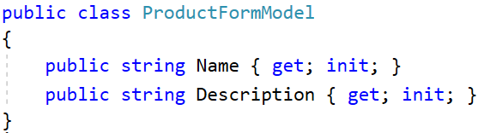
Controller
Controllers should be responsible only for the request and response
Inject the service through the constructor
public class ProductsController : Controller
{
private IProductService productService;
public ProductsController(IProductService service)
=> this.productService = service;
public IActionResult Create() => View();
[HttpPost]
public IActionResult Create(ProductFormModel model)
{
if (!ModelState.IsValid) return View(model);
this.productService.CreateProduct(model.Name, model.Description);
return RedirectToAction("All");
}
}
Invoke service methods for the business logic

Slide 64
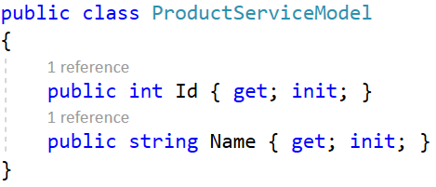
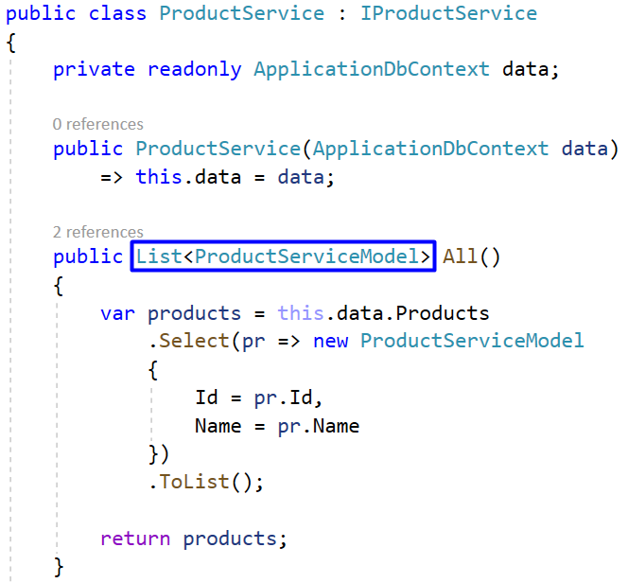
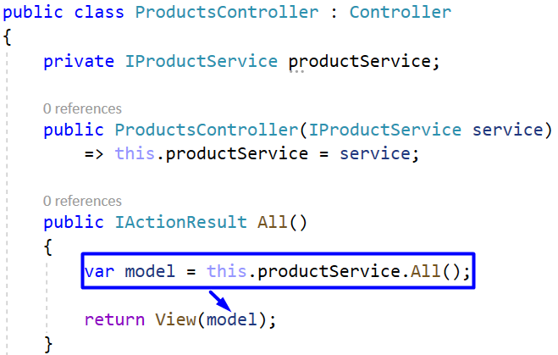
Service with Service Model
Special model for the service

Slide 65

Summary
Model Binding
Model Validation
Working with Files
Razor syntax
Layout and Special View Files
HTML Helpers and Tag Helpers
Partial Views and View Components
Dependency Injection and Services
Layout and Special View Files
…
…
…

Slide 66
Questions?
Notes:
66

Slide 67













SoftUni Diamond Partners

Slide 68

Educational Partners

Slide 69
Trainings @ Software University (SoftUni)
Software University – High-Quality Education, Profession and Job for Software Developers
softuni.bg, softuni.org
Software University Foundation
softuni.foundation
Software University @ Facebook
facebook.com/SoftwareUniversity
Software University Forums
forum.softuni.bg
Notes:
69

Slide 70

License
This course (slides, examples, demos, exercises, homework, documents, videos and other assets) is copyrighted content
Unauthorized copy, reproduction or use is illegal
© SoftUni – https://softuni.org
© Software University – https://softuni.bg
Notes:
70

